Slide 1

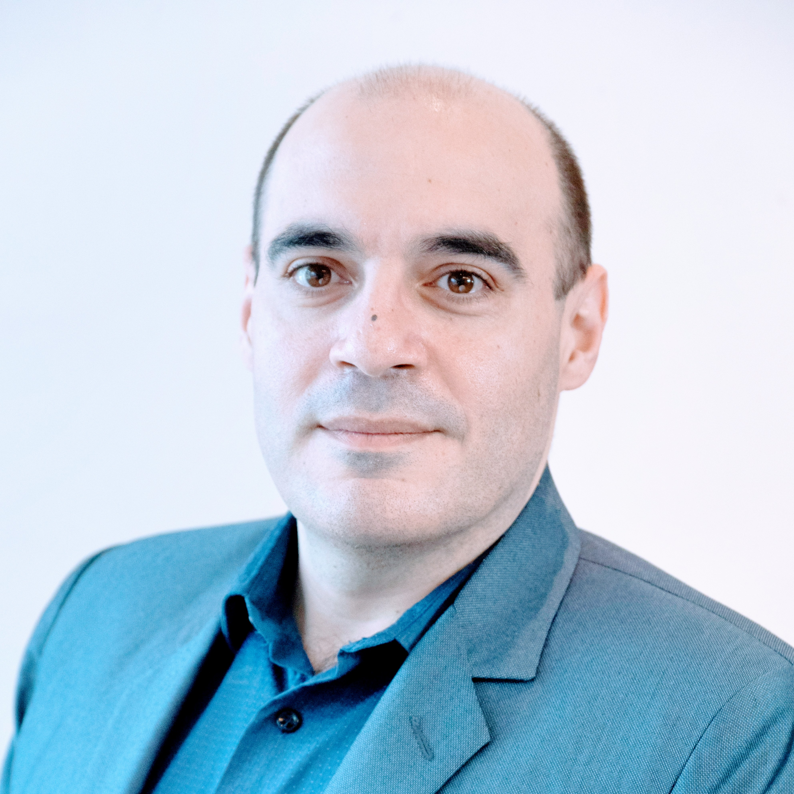


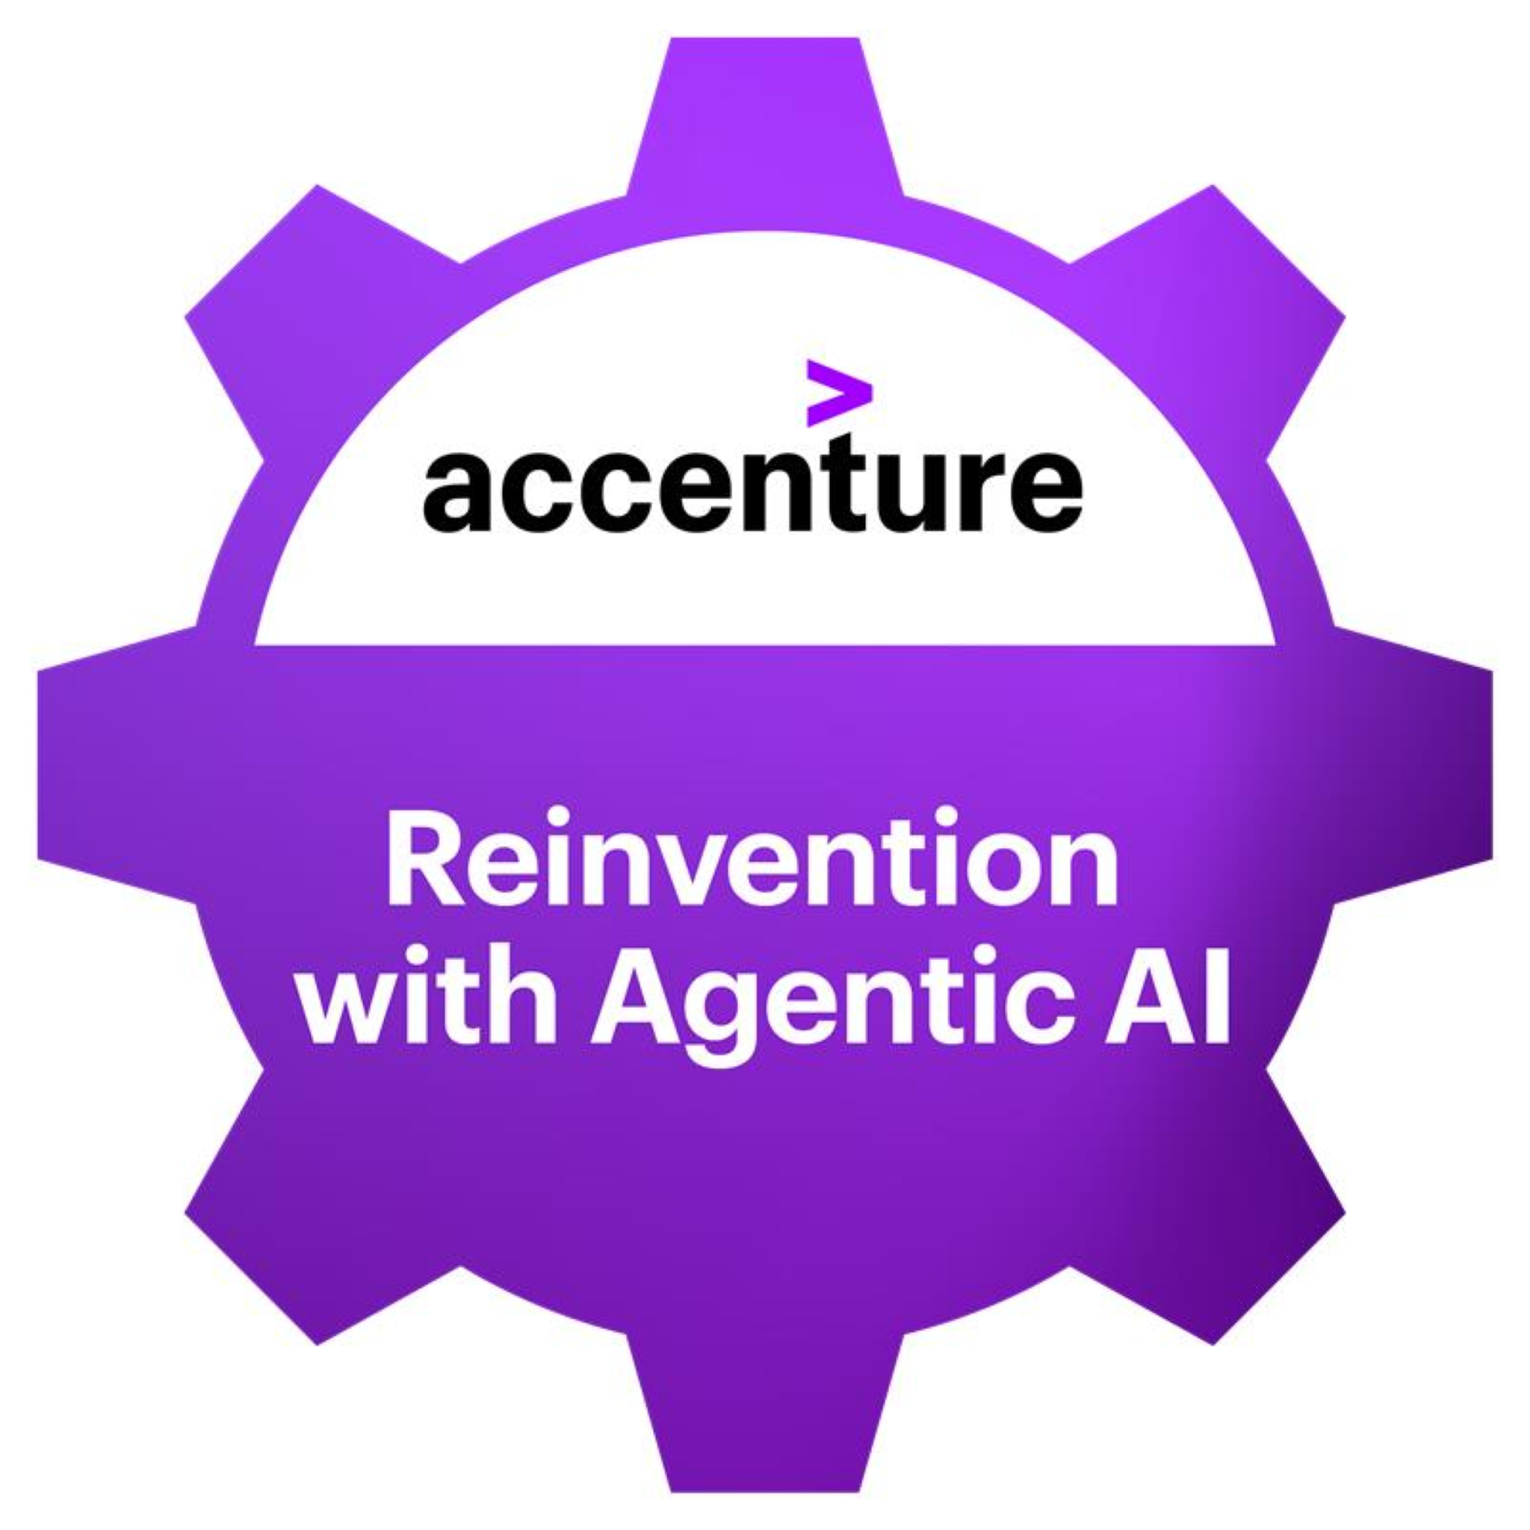

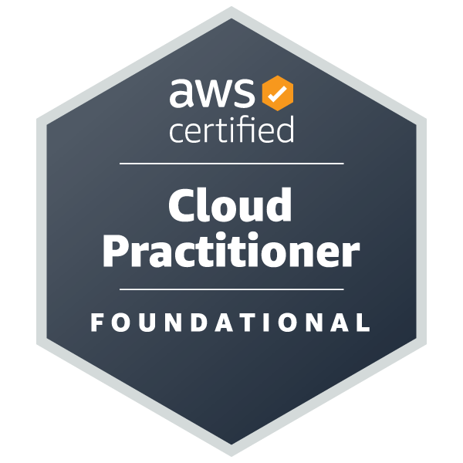
Ricardo Di Pasquale
SELECTED EXPERIENCE
Accenture D&AT
AI/ML SME – Snowflake driven Datalake Conversational AI
AI/ML SME – Gemini Enterprise PoC for Competitive Intelligence (unstructured data)
AI/ML SME – Novel text-to-sql product based on Knowledge Graph + Agentic AI
LLMOps / MLOps Lead @ Content and Media Company, USA
MLOps Lead - GCP Vertex Platform - Building of a AI Assisted DATA tool for migration and automatic documentation of pipelines.
Data Science Platform Enablement @ Luxury vehicles Manufacturer, GERMANY
Architecture Lead
GCP Cloud Migration @ WORKD IWDE RETAIL COMPANY, USA
Architecture Lead / HC Lead - Data Lake Migration. Architecture Design for automated migration - Dataproc/Spark/Hive/GCP/Airflow
MLE CONSULTING @ WORKD IWDE COMMUNICATION COMPANY, SWEDEN
MLOps team Lead - MLOps Framework Adoption. AWS –SageMaker
MLE CONSULTING @ International Tires Manufacturer, USA
MLOps team Lead - MLOps Framework Adoption. AWS – SageMaker
DATA PLATFORM ASSESSMENT @ WORLDWIDE FAST-FOOD COMPANY, USA
Technical Strategist Lead - Assessment of current transactional world-wide platform
INFORMATION SYSTEM MANAGEMENT @ ELECTRIC ENERGY WHOLESALE MARKET ADMINISTRATION COMPANY, ARGENTINA
IS Manager.
PEDIATRIC CHEST X-RAY CLASSIFICATION @ PEDIATRICS HOSPITAL, ARG.
Project Director
CARDHOLDERS & COMMERCE TRANSACTIONAL WEB SITES @ GLOBAL CREDIT CARD PROCESSOR, ARGENTINA
Sr Application Architect
AI/LLM Technology Architecture Associate Director
Technology / AI
ricardo.di.pasquale@accenture.com
Buenos Aires, Argentina
PROFESSIONAL BACKGROUND
AREA OF EXPERTISE
30 years of experience in Software Engineering, Data Science and AI Eng. Data Science Program Director, AI Eng. Program Director, Professor & Researcher in UCA (Pontificia Universidad Católica Argentina). AI Tribe Leader. Responsible for Scale.AI, AI Enginering, AI Assisted SDLC and AIOps.
HARD/SOFT SKILLS & TOOLS
AI Engineering, Data Science, AI/Ops, AI Governance, AI-Assisted SLDC, MLE/MLOps
Dev: Java, Scala, C#, Python, C++
DB: Oracle/SQLServer/DB2/PostgreSQ/ MySQL/Neo4J/MongoDB/InfluxDB
AI: LLM & ML/SageMaker/Vertex/ AzureML/Databricks/ OpenAI / Gemini / Bedrock / Claude / TensorFlow/Pytorch/ Scikitlearn/XGBoost/LigthGBM
Others: Scaled.AI, MLE, MLOps, Software Engineering, Project Management, Big Data Optimization, Scalability, Researching, Architecture
EDUCATION
Bachelor Degree in Computer Engineer (Pontificia Universidad Católica Argentina)
Master Degree in Software Engineering (ITBA – Universidad Politécnica de Madrid)
PhD Candidate in Science & Technology (UNGS)
LANGUAGES
INDUSTRY
English (C1)
Spanish (Native)
Italian (Basic)
Energy
FS / Banking
Health Sciences
Retail
Accenture
4

